Slide 1




ibex x Transcard
Technology Deep Dive
October 7th 2024

Slide 2







INTRODUCTIONS
Andy Wilkens Chief Technology Officer
Bryan Larimore SVP, Business Development
﻿Mike Hallowell Global Head of Sales
Sandra Fernandez SVP, Compliance and Risk Management
Mubsshar Ismail
VP, IT Security
Zeeshan Ahmed
AVP, IT Solutions Architect
Waslq Ashfaq
Sr. Director, Software Development

Slide 3


Introductions
IT Infrastructure
BCP Capabilities
Wave iX
Security Framework
Compliance and Risk Management
Questions
Agenda
3
Notes:
NEW LIST OF ATTENDEES FOR VIRTUAL TOUR:
Kevin Stephenson
Chad Hager
Fabiola Arrona
Ben Jaddidi
Stephenie
Tony Gardner
Sheri Johnson
Shonda Johnson
Shunda Gray

Slide 4


World-Class Enterprise-Grade Infrastructure
Redundant Data Centers
Equinix Facility – Dallas TX
Equinix Back up Data Center – Ashburn, VA
Redundant Voice & Data Infrastructure
Dual MPLS networks – AT&T, Century Link, C&W, Digicel, PLDT and Globe
Redundant Internet and firewall infrastructure
Redundant, Highly Available core
Redundant Cisco network core
Redundant VMWare Server Farms
Highly Available Storage Area Network (SAN)
Backup UPS and Generator
Compliance & Certifications
A PCI DSS Level One Certified Organization
ISO 27001 compliant at selected sites
SOC 2 Type II at selected sites’
HITRUST r2 at selected sites
24x7x365 Infrastructure Staff Coverage
In-Band and Out-of-Band Management Tools
Full network and system instrumentation and monitoring
Cisco IP SLA for performance monitoring
Dedicated Service desk, Incident Management, NOC, Server Operations, Procurement and Security Teams
Scheduled Field Services support at the site level
24x7 Command Center
What Does It Mean for You?
BCP
Scale with speed (Burst Capacity)
Financial-Grade Compliance
Global Security Infrastructure & Certification • ISO 27001​ • PCI DSS. • SOC 1 Type II​ • SOC 2 Type II​ • NIST 800-53/FISMA​

Slide 5
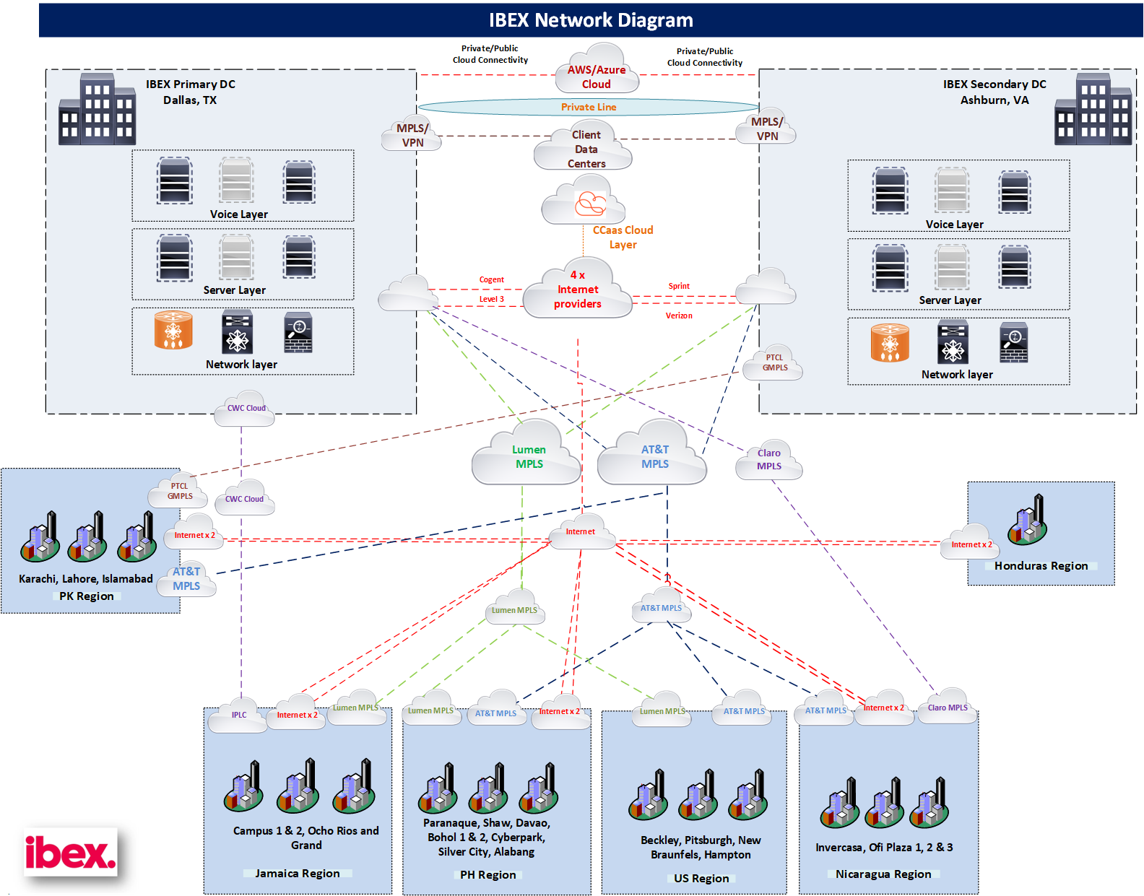

Network Connectivity

Slide 6

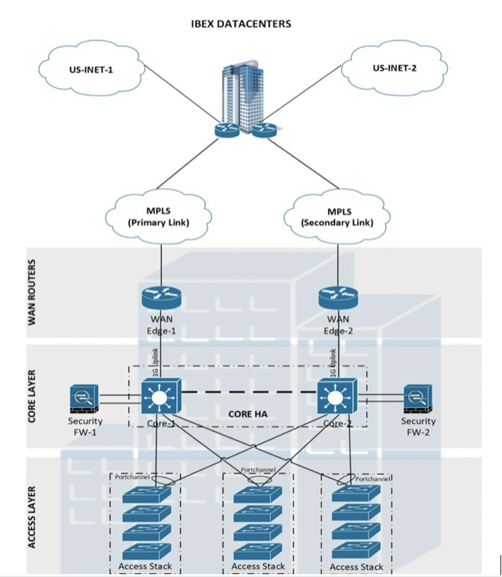

BCP Capabilities
Infrastructure built with BCP in mind
Global BCP Plan Updated Annually
Well defined RTO and RPO
Site Response Plans updated regularly
Site Power
Weekly Generator testing
Quarterly UPS/Genset tests
Maintenance contracts on all power systems
Fuel contracts to ensure continued operations
Hot Stand-by Equipment
Fire Suppression
Robust response plan to natural calamities
Robust data backup processes
Disaster Recovery Strategy
Physical Recovery – First level of recovery
Site Accessibility
Power/Electricity restoration
Repairs (if needed)
Technical Recovery
Local carrier recovery
network restoration
Site Recovery Communication
Employee Communication
Client Communication
Incident Management Team
Satellite Phones at every site
Out of band notification system with Zoom DR bridges
Employee hot line
Employee Transportation when required
Stocked Concessions

Slide 7




Introducing
The AI Customer Experience Platform
Wave iX is an AI-enhanced suite of solutions powering next-generation customer interactions.

Slide 8
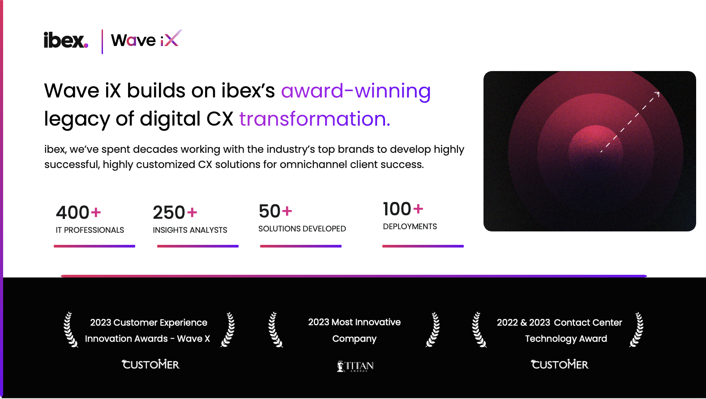






Wave iX builds on ibex’s award-winning
legacy of digital CX transformation.
ibex, we’ve spent decades working with the industry’s top brands to develop highly successful, highly customized CX solutions for omnichannel client success.
400+
IT PROFESSIONALS
250+
INSIGHTS ANALYSTS
50+
SOLUTIONS DEVELOPED
100+
DEPLOYMENTS
2023 Customer Experience Innovation Awards - Wave X
2023 Most Innovative
Company
2022 & 2023 Contact Center Technology Award

Slide 9
The New Age of Generative CX
Wave iX combines ibex’s years of award-winning BPO operational excellence with Generative AI to augment humans, insights, and action across the end-to-end CX value chain.
Agent^{AI}
Customer^{AI}
Insights^{AI}
THE AGENT PERFORMANCE SUITE
THE CUSTOMER INTERACTIONS SUITE
THE CX INSIGHTS SUITE
The leading AI suite for agent productivity and workflow enhancement. Integrates across the agent experience to drive enhanced outcomes for every agent action.
AI technology that boosts every interaction along the customer journey, using the latest in Generative AI.
An end-to-end insights layer measuring real-time CX interaction data supported by a Business Intelligence team surfacing insights that drive business forward.

Slide 10
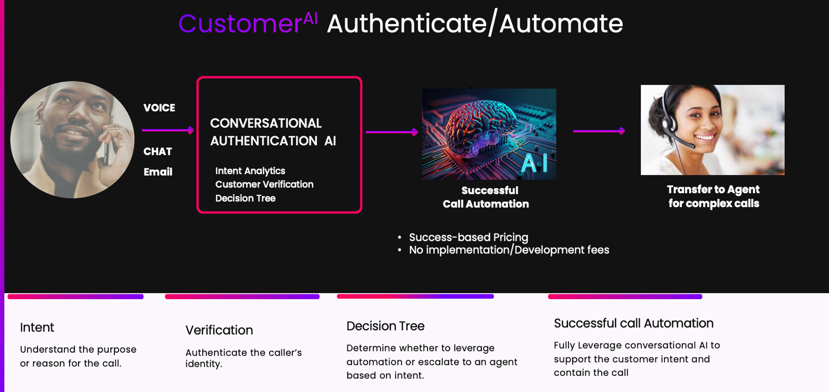

Slide 11
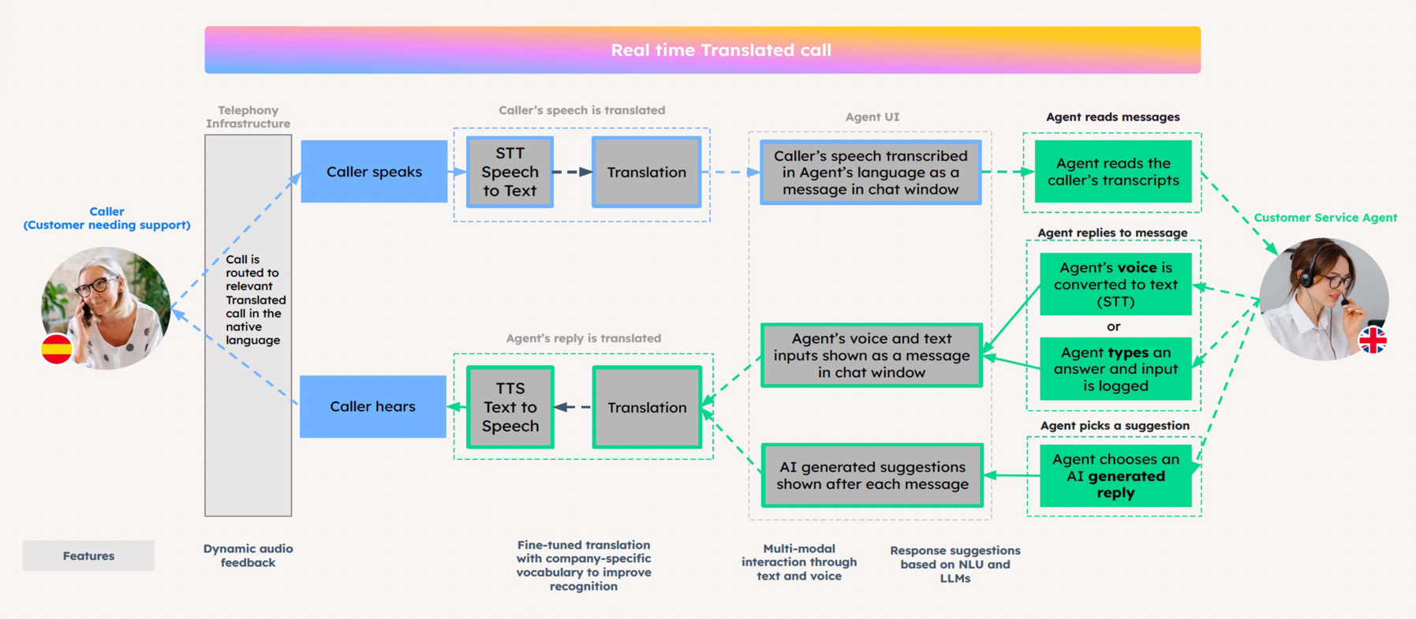
The Age of Generative CX
Translate

Slide 12







Cybersecurity Framework
NIST based Cybersecurity Framework
Identify
Protect
Detect
Respond
Recover
Sentinel One Ranger Pro
Burp Suite
Trusted Site VA Scanner (External)
Rapid7 InsightVM
Rapid7 CloudSec
Sentinel One
CyberArk PAM
Duo MFA
CISCO AnyConnect
CISCO SBL
CISCO Umbrella
Palo Alto Wildfire
Proofpoint
Barracuda ESG
Forcepoint Host Based DLP
MDM – MS Intune
Disk Encryption
Manage Engine DTC
Vectra.AI - NDR
Rapid7 iDR
Security Score Card
SolarWinds
AD Audit Plus
Enzoic for AD
Pentera Automated Pen Testing
Sentinel One Vigilance Pro MDR SOC services 24x7
Rapid 7 iDR
Proofpoint
Internal CERT
Redundancy for
Data Centers
Carriers
ISPs
Route 53 for IBEX DNS
Backup of critical Data in Data Centers
Segregation of Backups
Remote Out of Band access
Global Security Infrastructure & Certification • ISO 27001​ • PCI DSS. • SOC 1 Type II​ • SOC 2 Type II​ • NIST 800-53/FISMA​

Slide 13





Global Information Data Security/Risk & Compliance Programs
Security and Compliance is built into our DNA, and carried throughout the organization as core postures at Ibex
Compliance & Certifications - A PCI DSS Level One Certified Organization, SOC 2 Type II, and ISO 27001 at selected sites.
PCI/DSS Paperless environment
Superior & Manager inspection process
Information & Data Protection
Witness Secure Technology that constantly records keystrokes, calls and actively flags, where applicable
Badge Access Control limited to as needed basis
Visitor/vendor access policies
Centralized Incident Management system
Physical Controls
On Site Security
CCTV in each location
Motion Detectors
Operational Controls & Technology
Third Party Ethics/Fraud Hotline
Transaction and call monitoring & recording
Email DLP
Full suite Technology monitoring, encryption and protection protocols
Training Awareness and Accountability
Mandatory Annual Security Awareness
Annual Mandatory Regulatory Training
Mandatory Annual Integrity Awareness
Compliance Workshops
Ongoing risk assessments
Full BCP/DR planning and recovery
Internal Audits
Governance / Oversight
Centralized Policy Repository
Align Compliance Policies/Accountability & Enforcement
Compliance Roadshows

Slide 14
Compliance - Process Monitoring & Awareness
PROCESS
CULTURE
Monitoring
Internal Risks/ Assessment
Training & Development
Policies & Procedures
Internal Risk Assessments
PCI Checks
PC Checks
Physical Security Assessments
Building Physical Access Controls
Exterior Entry / Exit Points
CCTV / DVR Placement and Retention
Physical Controls for Data Center/Server Room/IDF/MDF
Physical Key Management
DPIAs
vDPIAs
Call Flow Behaviors Outliers
Fraud/Compliance Violation Detection
Ibex Witness, where applicable
DLP
Privacy Review Board
Lighthouse 3rd Party Whistleblower Hotline
Compliance Tradeshows
Annual Management Training
Regulatory Training Library
Security Awareness
Data Privacy
GDPR
Anti-Money Laundering and Anti Bribery and Corruption
HIPAA and FWA
FDCPA
Annual Review of Policies and Procedures - Compliance
Align Compliance Policies/Accountability & Enforcement
Centralized Compliance Policies
Escalation Process - Procedure gaps sent to Compliance for review/investigations
Continuous Education - Create an environment of awareness and development

Slide 15

Thank you!

Slide 16

Appendix

Slide 17

BPO 3.0: REAL SOLUTIONS, NOW.
Customer^{AI}

Slide 18



Current Mint Mobile IVR Experience
Click the icon(s)
to listen
Dramatic change in Engagement
On Brand Voice Opportunity
Experience
Claim Demo

Slide 19
After listening for 9 days our classifier is continuing to get better, and we are confident in getting quick wins with initial automation opportunities
Consistent &
Exciting Results
Total Inbound Calls
Total Days
Intents Classified
87K
9
94.5%
Total # of calls received via the Listener system
Number of days in listen mode
% of total calls Wave iX AI was able to classify into intents

Slide 20

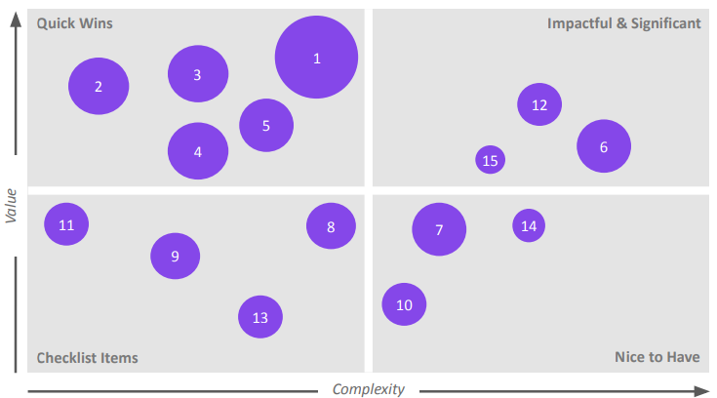
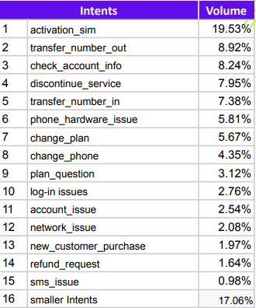
Intent Coverage and Automation
Let's leverage current listen mode insights to identify key intents to drive automation, and get some quick wins

Slide 21
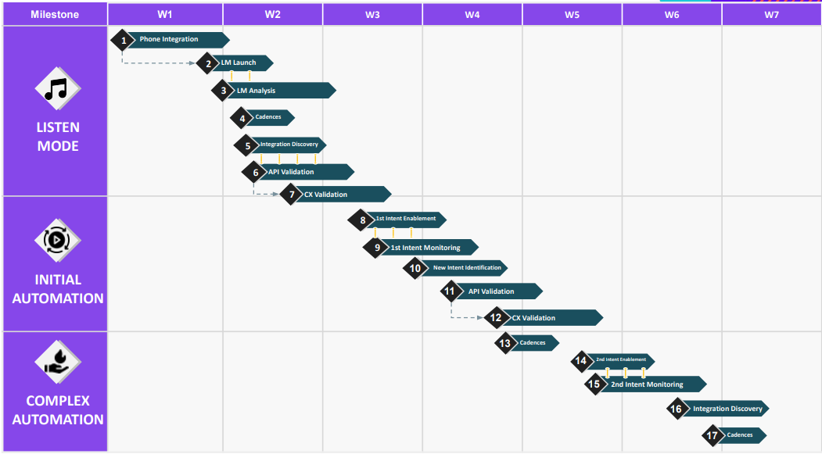
Industry Leading Speed to Implementation

Slide 22
The Age of Generative CX
BPO 3.0: REAL SOLUTIONS, NOW.
Agent^{AI}
22

Slide 23

Translate
The Age of Generative CX

Slide 24

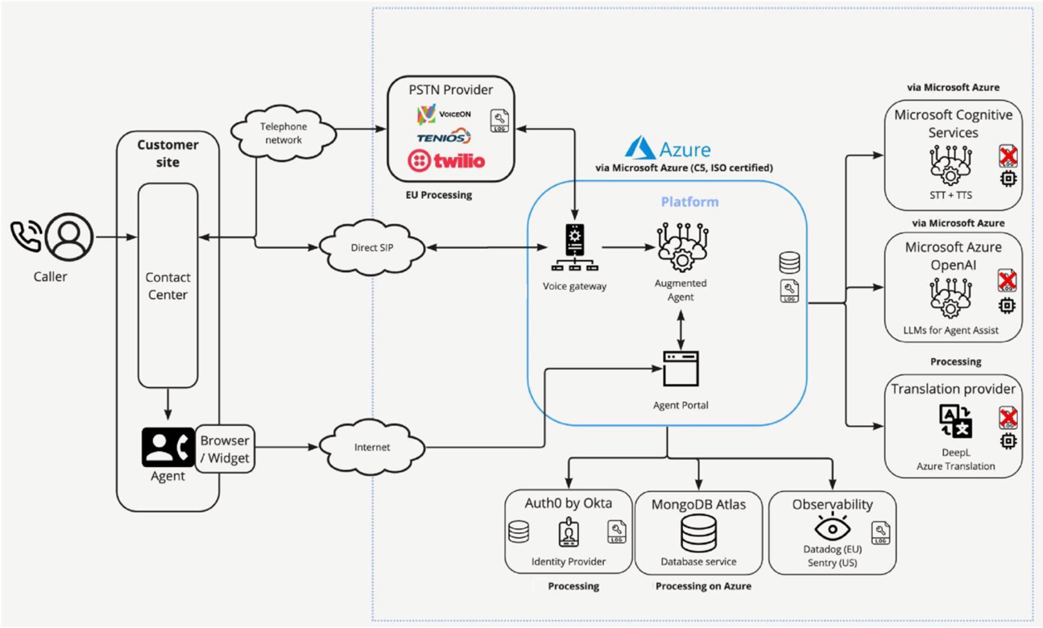
The Age of Generative CX
Technical Architecture

